Slide 1
Ethics and Trade
Steven Suranovic
George Washington University
September 2020

Slide 2
The Self-Interest Requirement
Self-interest is needed to assure gains for both
Relax (change) the assumptions → Changes the results
Suppose Smith is self interested
But, suppose Jones believes in self-sufficiency
In this case Jones has no motivation to trade with Smith
So trade would not occur and Smith loses surplus
Jones prefers self-sufficiency to extra surplus value

Slide 3
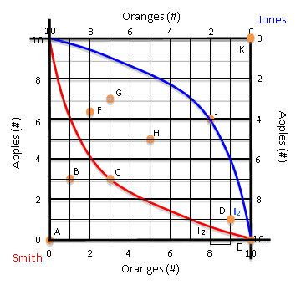
Does Trade really maximize Utility?
Is trade to H or G (ie. into the lens) best for Smith?
No, Smith’s utility is maximized at point K
Is trade to H or G best for Jones?
No, Jones’ utility is maximized at point A

Slide 4
Does Trade really maximize Utility?
Movement from E to (A or K) is not trade
Trade involves a quid pro quo
Movement from E to K would mean Jones is transferring 10 apples to Smith and getting nothing in return

Slide 5
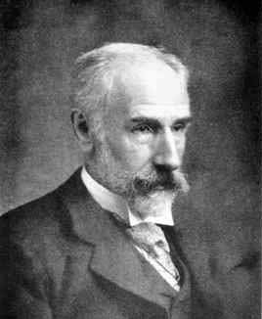
Francis Edgeworth (1845-1926)
The first principle of economics is that every agent is actuated only by self-interest. The workings of this principle may be viewed under two aspects, according as the agent acts without, or with, the consent of others affected by his actions. In wide senses, the first species of action may be called war ; the second, contract.
Mathematical Psychics, An Essay on the Application of Mathematics to the Moral Sciences, 1881.

Slide 6
Francis Edgeworth (1845-1926)
Contract refers to an agreement
eg. I’ll give you 5 oranges if you give me 5 apples.
War refers to the taking of goods by force or with superior power
One option for Smith and Jones is to battle it out. The winner goes home with all the apples and oranges.

Slide 7
An Implicit Assumption to Cooperate and Trade
The Pure exchange model assumes they engage in contract, not war.
→ They accept property rights
What’s mine is mine, what’s yours is yours, until or unless we engage in mutually voluntary trade.
They accept the moral code, “Thou Shalt not Steal”
→ they agree not to use force or coercion, violence, or threats against the other to gain an advantage.

Slide 8
What if agents don’t accept Contract?
If theft and violence occur – the outcome is win-lose
The more powerful agent gains, the other loses
If there is a threat of violence and coercion at the market
→ don’t go to the market to attempt trade
No trade → no mutual benefits (the potential for gains is lost)

Slide 9
The assumption prohibiting deception
Relax (change) the perfect information assumption
We assumed earlier – agents know perfectly the quality of the other goods … but what if they don’t know.
Imperfect knowledge opens the door for agents to deceive each other
To say your goods are good, when they are not
To embellish the qualities (eg. an apple a day keeps the doctor away)

Slide 10
What if agents use deception?
Trade may still occur and may be mutually voluntary
Because the decision to trade is based on the expectations of the goods quality.
When expectations are not fulfilled though, utility increase is less than expected.
Agent may lose from deceptive trade
Or, agent may gain, but not as much as anticipated.
Deception is discouraged, though, to acquire repeat business

Slide 11
Assumption Highlights
Economics Assumption
Assume TRADE is MUTUALLY VOLUNTARY
Ethics Equivalent
Acceptance of PROPERTY RIGHTS
NO THEFT
NO FORCE and NO THREATS of Force
Agents do not inflict injury ; don’t intimidate to get better terms;
FREEDOM to trade or not

Slide 12
Assumption Highlights
Economics Assumption
Assume there is PERFECT INFORMATION
Ethics Equivalent
No LYING or DECEPTION
Agents represent their products accurately
PROMISES ARE KEPT
Agents follow through and complete transactions
Fulfillment of Contracts

Slide 13
Pure Exchange Model Implications
If two people, pursuing only their individual self-interest trade X for Y with each other mutually voluntarily and with perfect information, then
Both traders benefit from trade
Or, trade is Win-Win
Note that every day around the world billions and billions of transactions occur. If the above conditions prevail, then all of this activity is raising the well-being of all traders.

Slide 14
Pure Exchange Model Implications
Self-Interest with Ethical constraints → beneficial outcome for everyone
→ business profit is a measure that the firm has produced benefits for many others; more profitable → more good for society
Self-interest without ethical behavior → likely to be a win-lose outcome
Can define this latter situation as GREED
Note TV-Show American Greed Episodes - all(?) of them involve some sort of deception or theft.

Slide 15
Are the Ethical Assumptions satisfied in the real world?
Have you ever willingly purchased a product and been satisfied with the outcome?
Is this outcome frequent or rare?
For what percentage of transactions does that occur?
Think of examples when it does not occur …

Slide 16
Friedman on Shareholder Value
“On September 13th, 1970, the New York Times Magazine published an essay by Milton Friedman entitled “The Social Responsibility of Business Is to Increase Its Profits,” which turned out to be one of the most influential economic arguments of the century.” … NYT
1970 Quote: “there is one and only one social responsibility of business—to use its resources and engage in activities designed to increase its profits …”
“ … so long as it stays within the rules of the game, which is to say, engages in open and free competition without deception or fraud.”

Slide 17
Enforcing the “Rules of the Game”
PRIVATE MECHANISMS
Fences, walls, locks, safes
Religion
Family/community pressures
Schools, philosophy education (also a public mechanism)
PUBLIC MECHANISMS
Local Police
National military
Judicial system
Laws against theft, violence and deception
Courts, judges, for enforcement

Slide 18
New Terminology in Pure Exch Model
Perf. Info and MVE called a perfect market
Violations of ethical principles called a market imperfection
Institutions have arisen to help “correct” market imperfections
Public Mechanisms (Government) can help “solve” these problems → there is a role for government
Private Mechanisms (eg religion) also help “solve” these problems → there are solutions that do not require government

Slide 19
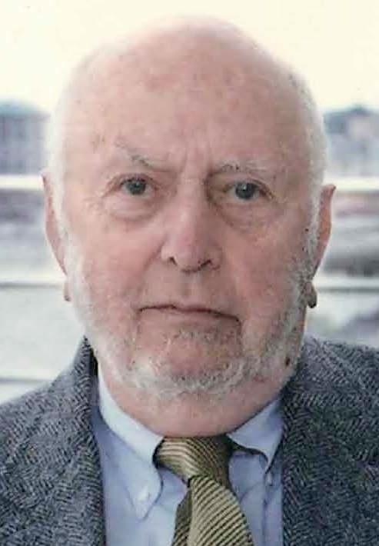
Douglass North (1920-2015)
Nobel Prize 1993
Institutional Economics
Argued that institutions (eg, religions, government, police, etc) act to reduce “transactions costs” and thereby makes trade easier.
For example, I might not loan money to Smith because he might not pay me back. But if I can use the judicial system to sue Smith if he doesn’t pay, then I am willing to lend.

Slide 20
Pure Exchange Model with Intermediaries
An intermediary is a person/business that helps facilitate trade by reducing transaction costs.
Can only arise when there is imperfect information, therefore the following story relaxes that assumption.
Suppose Smith and Jones would like to trade with more people but can’t find others to trade with
Suppose a third person, named JB, creates an internet platform that enables the two to find each other and trade.

Slide 21
Pure Exchange Model with Intermediaries
The internet platform has many features. Can post photos of product, can give detailed descriptions and can have customer reviews posted.
In return for this service, JB charges both Smith and Jones a small fee, payable in apples or oranges.

Slide 22
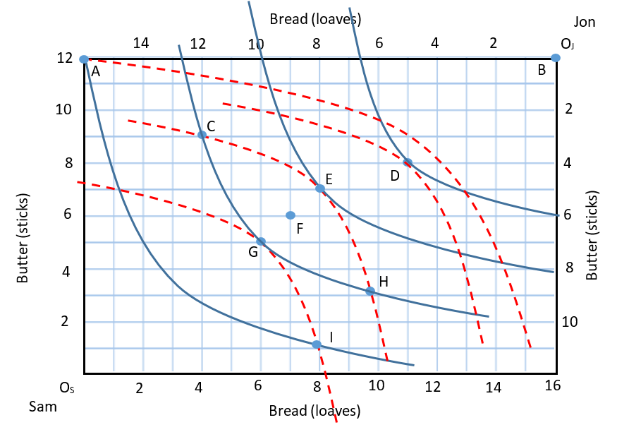
Pure Exchange Model with Intermediaries
Suppose Sam and Jon trade A to F using JB’s platform.
JB collects a fee of 1 loaf and 1 stick from both Sam and Jon.
Where is Sam’s (Jon’s) new consumption bundle?
After paying the fee is Sam (Jon) better-off than before trade?

Slide 23
Pure Exchange Model with Intermediaries
How many bread loaves and butter sticks does JB end up with?
Is JB better-off after this transaction than before?
Answer will depend on the cost of the internet platform.
However, if you recognize which JB we’re referring to here, I think we’d all agree he’s doing OK.

Slide 24
Pure Exchange Model with Intermediaries
Since Sam and Jon both receive surplus value trading to F, they can afford to give some of it the JB in exchange for a service that reduces the cost of finding trading partners.
All parties benefit from this outcome.

Slide 25
HFT in the Stock Market
Michael Lewis’ book, Flash Boys, explains the world of High-Frequency trading (HFT) in the stock market
HFT is similar to Front-running
Using knowledge of a pending large buy-order, front-running means buying a stock before the large trade, then selling it back after the large trade has raised the price.
Front-running gives a sure profit using “inside information”
Front-running is illegal

Slide 26
HFT in the Stock Market
Suppose a HFT firm learns that Sam and Jon are about to trade to point F.
Before executing the trade the HFT firm jumps in between and trades with Jon to point E and with Sam to point G
HFT firm walks away with 2 loaves and 2 sticks

Slide 27
HFT in the Stock Market
HFT firms learn of the trade to F microseconds before it is executed, and their buying and selling is also conducted in microseconds.
Distances between stock exchange servers make it possible
HFT firms conduct millions of trades each day and collect tiny amounts on each trade
HFT firms made over $10 billion around 2010

Slide 28
HFT in the Stock Market
HFT firms gain by stealing surplus from Sam and Jon.
Sam and Jon still trade, but they pay a very small and therefore unnoticed fee
HFT firms say they are providing valuable services
But, no one is free to choose the services
Also, some traders have worked to reduce their susceptibility to HFT

Slide 29
The Trojan Program Story
Suppose you design a Trojan computer program that can secretly bore into all US bank computers and transfer money from all deposit accounts into a secret Swiss bank account in your name.
Suppose you design the program to withdraw 0.001% from every deposit account
Thus, a $100,000 account would have only $1 withdrawn. A $10,000 account, … 10 cents.
These amounts are too small to be noticeable.

Slide 30
The Trojan Program Story
Total US Bank deposits in 2020
$15 trillion
Total amount of money transferred to your Swiss bank account
$150,000,000
This is a way to get rich without anyone suffering a noticeable loss
If you knew you would not get caught, would you do it?

Slide 31
The Trojan Program Story
Is it Right? Ethical?
This is clearly theft. Property rights are violated
It is clearly illegal.
Depositors did not choose to give their money away.
Income inequality rises

Slide 32
The Happy App Program Story
Suppose instead you design a Happy App program that presents a user a new and unique and short happy video whenever you login. Think Tiktok!
Suppose you charge the user $1 for unlimited access to the happy videos.
Suppose 150 million people purchase the Happy App.
Your revenues? $150,000,000

Slide 33
The Happy App Program Story
This is also a way to get rich without anyone suffering a noticeable loss
Is it Right? Ethical?
This is clearly mutually voluntary exchange
Purchasers spent $1 because they expect to receive more than $1 in utility
Both sides benefit from trade
Income inequality also rises

Slide 34
Trojan/HappyApp Lessons
With the Trojan, self-interest is satisfied by reducing utility of many others (this is theft and greed)
Income inequality caused in this way is unjust.
With HappyApp self-interest is satisfied while creating even more value for others.
Consumers gain more that $150 million in utility
The same income inequality arising here is not unjust.

